Slide 1
Logic Synthesis
Exploiting Don’t Cares in
Logic Minimization

Slide 2
Node Minimization
Problem:
  Given a Boolean network, optimize it by minimizing each node as much as possible.
Note:
  The initial network structure is given. Typically applied after the global optimization, i.e., division and resubstitution.
  We minimize the function associated with each node.
  What do we mean by minimizing the node “as much as possible”?

Slide 3
Functions Implementable at a Node
In a Boolean network, we may represent a node using the primary inputs {x₁,.. x_{n}} plus the intermediate variables {y₁,.. y_{m}}, as long as the network is acyclic.
DEFINITION:
A function g_{j}, whose variables are a subset of {x₁,.. x_{n}, y₁,.. y_{m}}, is implementable at a node j if
  the variables of g_{j} do not intersect with TFO_{j}
  the replacement of the function associated with j by g_{j} does not change the functionality of the network.

Slide 4
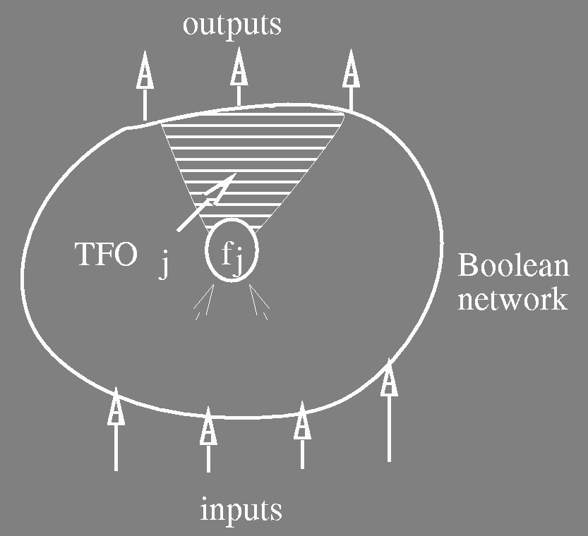
Functions Implementable at a Node
The set of implementable functions at j provides the solution space of the local optimization at node j.
TFO_{j} = {node i s.t. i = j or ∃ path from j to i}

Slide 5
Prime and Irredundant Boolean Network
Consider a sum­of­products expression F_{j} associated with a node j.
Definition:
F_{j} is prime (in multi­level sense) if for all cubes c ∈  F_{j}, no literal of c can be removed without changing the functionality of the network.
Definition:
F_{j} is irredundant if for all cubes c ∈ F_{j}, the removal of c from F_{j} changes the functionality of the network.

Slide 6
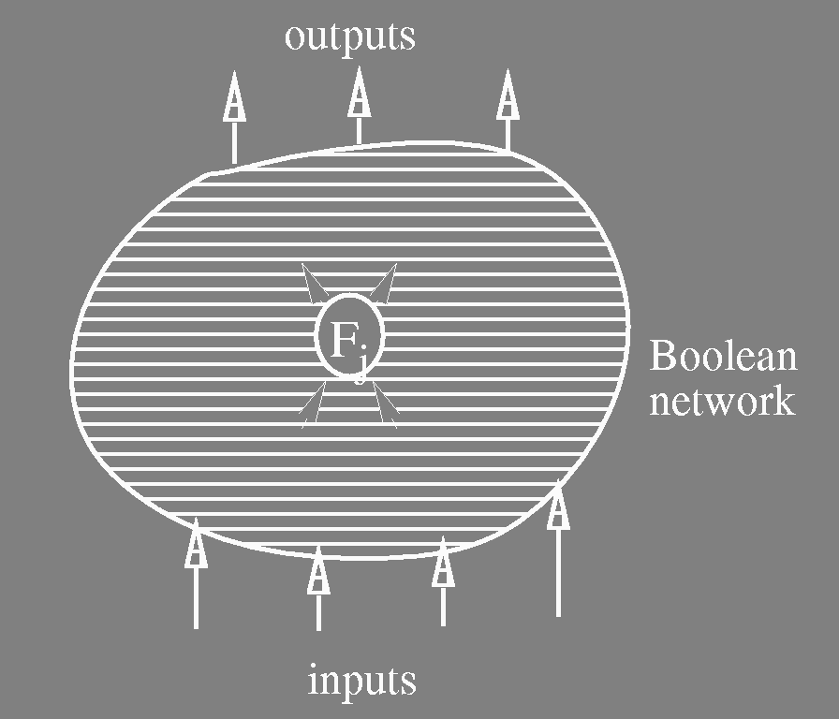
Prime and Irredundant Boolean Network
Definition:
A Boolean network is prime and
irredundant if F_{j} is prime and irredundant
for all j.
Theorem:
A network is 100% testable for single
stuck­at faults (s­a­0 or s­a­1) iff it is
prime and irredundant.

Slide 7
Local Optimization
Goals:
Given a Boolean network:
  make the network prime and irredundant
  for a given node of the network, find a least-cost sum­of­products expression among the implementable functions at the node
Note:
  Goal 2 implies the goal 1,
  But we want more than just 100% testability. There are many expressions that are prime and irredundant, just like in two-level minimization. We seek the best.

Slide 8
Local Optimization
Key Ingredient ­ Network Don't Cares:
External don't cares ­
  XDC_{k} , k=1,…,p, - set of minterms of the primary inputs given for each primary output
Internal don't cares ­ derived from the network structure
  Satisfiability Don’t Cares ­ SDC
  Observability Don’t Cares ­ ODC

Slide 9
SDC
Recall:
We may represent a node using the primary inputs plus the intermediate variables.
  The Boolean space is B^{n+m} .
However, the intermediate variables are dependent on the primary inputs.
Thus not all the minterms of B^{n+m} can occur:
  use the non-occuring minterms as don’t cares to optimize the node function
  we get internal don’t cares even when no external don’t cares exist

Slide 10

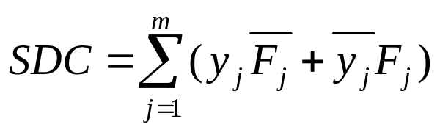
SDC
  Example:
  y₁ = F₁ = x₁
y_{j} = F_{j} = y₁x₂
  Since y₁ = x₁, y₁ ⊕ x₁ never occurs.
  Thus we may include these points to represent F_{j}
    ⇒ Don't Cares
  SDC = (y₁ ⊕ x₁)+(y_{j}⊕ y₁x₂)
  In general,
  Note: SDC ⊆ B^{n+m}

Slide 11

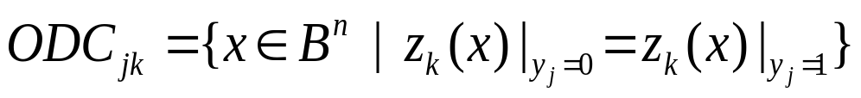
ODC
y_{j} = x₁ x₂ + x₁x₃
z_{k} = x₁ x₂ + y_{j}x₂ + (y_{j} x₃)
Any minterm of x₁ x₂ + x₂ x₃ + x₂ x₃
determines z_{k} independent of y_{j} .
The ODC of y_{j} for z_{k} is the set of minterms
of the primary inputs for which the value
of y_{j} is not observable at z_{k}
This means that the two Boolean networks,
  one with y_{j} forced to 0 and
  one with y_{j} forced to 1
compute the same value for z_{k} when x ∈ ODC_{jk}

Slide 12
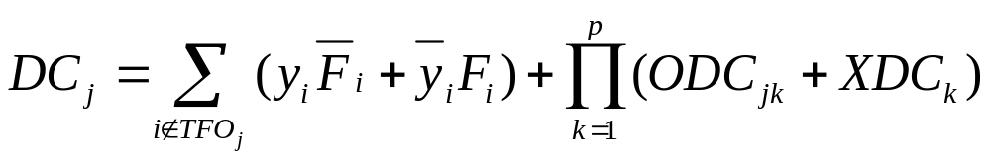
Don't Cares for Node j
Define the don't care sets DC_{j} for a node j as
ODC and SDC
illustrated:
outputs
ODC
F_{j}
Boolean
network
S
C
D
inputs

Slide 13
Main Theorem
THEOREM:
The function F_{j} = (F_{j}-DC_{j}, DC_{j}, F_{j}+DC_{j}) is the complete set of implementable functions at node j
COROLLARY:
F_{j} is prime and irredundant (in the multi-level sense) iff it is prime and irredundant cover of F_{j}
A least­cost expression at node j can be obtained by minimizing F_{j}.
A prime and irredundant Boolean network can be obtained by using only 2­level logic minimization for each node j with the don't care DC_{j} .
Note:
If F_{j} is changed, then DC_{i} may change for some other node i in the network.

Slide 14
Local Optimization ­ Practical Questions
How to compute the don't care set at a node?
  XDC is given
  SDC computed by function propagation from inputs
  How do we compute ODC?
How to minimize the function with the don't care?

Slide 15

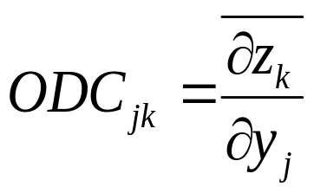
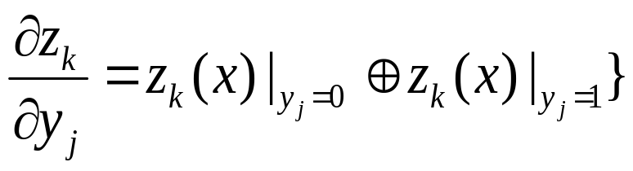
ODC Computation
z_{k}
g₁
g_{q}
g₂
y_{j}
x₁
x₂
x_{n}
Denote
where

Slide 16
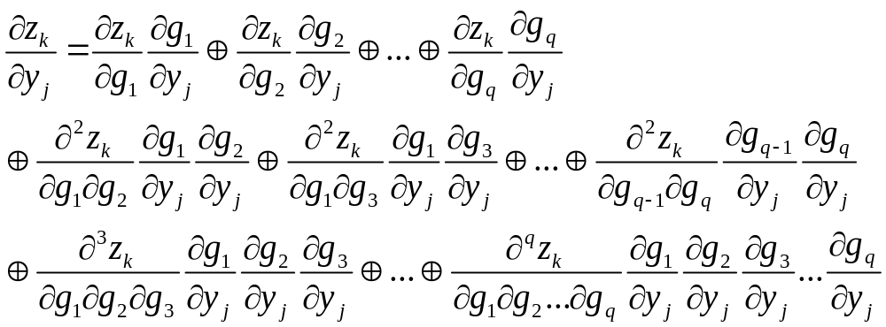
ODC Computation
z_{k}
In general,
g₁
g_{q}
g₂
y_{j}
x₁
x₂
x_{n}

Slide 17
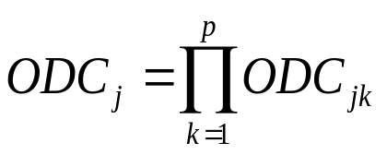
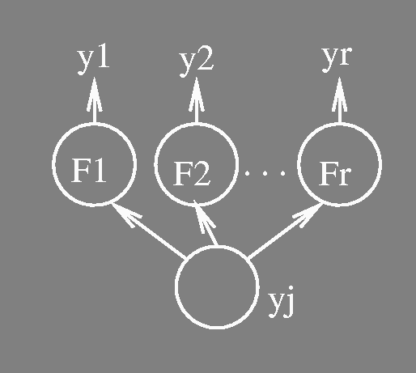
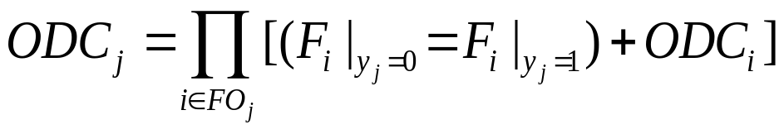
ODC Computation
Conjecture:
This conjecture is true if there is no reconvergent fanout in TFO_{j}.
With reconvergence, the conjecture can be incorrect in two ways:
  it does not compute the complete ODC. (can have correct results but conservative)
  it contains care points. (leads to incorrect answer)

Slide 18
Transduction (Muroga)
Definition:
Given a node j, a permissible function at j is a function of the primary inputs implementable at j.
The original transduction computes a set of permissible functions for a NOR gate
in an all NOR­gate network:
MSPF (Maximum Set of Permissible Functions)
CSPF (Compatible Set of Permissible Functions)
  Both of these are just incompletely specified functions, i.e. functions with don’t cares.
Definition:
We denote by g_{j} the function f_{j} expressed in terms of the primary inputs.
  g_{j}(x) is called the global function of j.

Slide 19
Transduction ­ CSPF
MSPF:
  expensive to compute.
  if the function of j is changed, the MSPF for some other node i in the network may change.
CSPF:
  Consider a set of incompletely specified functions {f_{j}^{C}} for a set of nodes j such that a simultaneous replacement of the functions at all nodes j∈j each by an arbitrary cover of f_{j}^{C} does not change the functionality of the network.
  f_{j}^{C} is called a CSPF at j. The set {f_{j}^{C}} is called a compatible set of permissible functions (CSPFs).

Slide 20
Transduction ­ CSPF
Note:
CSPFs are defined for a set of nodes.
We don't need to re-compute CSPF's if the function of other nodes in the set are changed according to their CSPFs
  The CSPFs can be used independently
  This makes node optimization much more efficient since no re-computation needed
Any CSPF at a node is a subset of the MSPF at the node
External don’t cares (XDC) must be compatible by construction

Slide 21
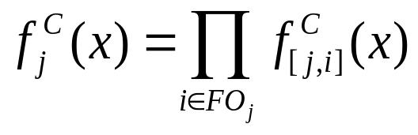
Transduction ­ CSPF
Key Ideas:
Compute CSPF for one node at a time.
  from the primary outputs to the primary inputs
If (f₁^{C} ,…, f_{j-1}^{C} ) have been computed, compute f_{j}^{C} so that simultaneous replacement of the functions at the nodes preceding j by functions in
(f₁^{C} ,…, f_{j-1}^{C} ) is valid.
  put more don’t cares to those processed earlier
Compute CSPFs for edges so that
Note:
  CSPFs are dependent on the orderings of nodes/edges.

Slide 22
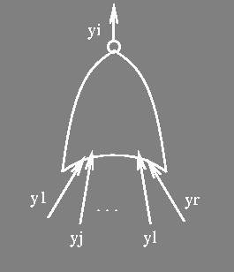
CSPF's for Edges
Process from output toward the inputs in reverse topological order:
Assume CSPF f_{i}^{C} for a node i is given.
Ordering of Edges: y₁ < y₂ < … < y_{r}
  put more don't cares on the edges processed
  earlier
  only for NOR gates
0 if f_{i}^{C}(x) = 1
f_{[j,i]}^{C}(x) = 1 if f_{i}^{C}(x) = 0 and for all y_{k} > y_{j}: g_{k}(x) = 0 and
g_{j}(x) = 1
* (don’t care) otherwise

Slide 23

Transduction ­ CSPF
Example: y₁ < y₂ < y₃
y_{i} = [1 0 0 0 0 0 0 0] output
y₁ = [0 0 0 0 1 1 1 1]
y₂ = [0 0 1 1 0 0 1 1]
y₃ = [0 1 0 1 0 1 0 1]
f_{[1,i]}^{C} = [0 * * * 1 * * *]
f_{[2,i]}^{C} = [0 * 1 * * * 1 *]
f_{[3,i]}^{C} = [0 1 * 1 * 1 * 1]
Note: we just make the last 1 stay 1 and all others *.
Note: CSPF for [1, i] has the most don't cares among the three input edges.
global
functions
of inputs
i
edge CSPFs

Slide 24
Example for Transduction
Notation:
[a’b’,a’b,ab’,ab]
g_{a} = [0011]
f^{C}_{a} = [0011]
g_{a} = [0011]
f^{c}_{ay} = [*011]
a
y
g_{y}= [0100]
f^{C}_{y} = [0100]
This connection can
be replaced by “0”
g_{a} = [0011]
f^{C}_{ac} = [0***]
b
c
g_{c} = [1000]
f^{C}_{c}=f^{C}_{cy} = [10**]
g_{b} = [0101]
f^{C}_{b}=f^{C}_{bc} = [01**]
a
y
b

Slide 25
Application of Transduction
Gate substitution:
  gate i can be replaced by gate j if:
    g_{j} ∈ f^{C}_{i} and y_{i} ∉ SUPPORT(g_{j})
Removal of connections:
  wire (i,j) can be removed if:
    0 ∈ f^{C}_{ij}
Adding connections:
  wire (i,j) can be added if:
    f^{C}_{j}(x) = 1 ⇒ g_{i}(x) = 0 and y_{i} ∉ SUPPORT(g_{j})
  useful when iterated in combination with substitution and removal

Slide 26
CSPF Computation
Compute the global functions g for all the nodes.
For each primary output z_{k} ,
f_{zk}^{C}(x)= * if x∈XDC_{k}
f_{zk}^{C}(x)= g_{zk}(x) otherwise
For each node j in a topological order from the outputs,
  compute f_{j}^{C} = Π_{i∈FOj}f_{[j,i]}^{C}(x)
  compute CSPF for each fanin
  edge of j, i.e. f _{[k,j]}^{C}
[j,i]
j
[k,j]

Slide 27
Generalization of CSPF's
Extension to Boolean networks where the node functions are arbitrary
(not just NOR gates).
Based on the same idea as Transduction
  process one node at a time in a topological order from the primary outputs.
  compute a compatible don't care set for an edge, CODC_{[j,i]}
  intersect for all the fanout edges to compute a compatible don't care set for a node.
  CODC_{j}= Π_{i∈Foj} CODC_{[j,i]}^{C}

Slide 28

Compatible Don't Cares at Edges
Ordering of edges: y₁ < y₂ < … < y_{r}
Assume no don't care at a node i
  e.g. primary output
A compatible don't care for an edge [j,i] is a function of
CODC_{[j,i]}(y) : B^{r} →B
Note: it is a function of the local inputs (y₁ , y₂ ,… ,y_{r}).
It is 1 at m ∈ B^{r} if m is assigned to be don’t care for the input line [j,i].

Slide 29
Compatible Don't Cares at Edges
Property on {CODC_{[1,i]},…,CODC_{[r,i]}}
Again, we assume no don’t care at output i
For all m∈B^{r}, the value of y_{i} does not change by
arbitrarily flipping the values of
  { y_{j}∈FI_{i} | CODC_{[j,i]}(m) = 1 }
no change
y_{i}
m is held fixed, but value
on y_{j} can be arbitrary
if CODC_{[j,i]}(m) is don’t care
i
k
j
CODC_{[k,i]}(m)=1
CODC_{[j,i]}(m)=1

Slide 30
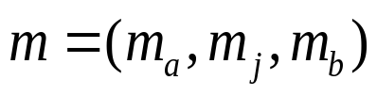
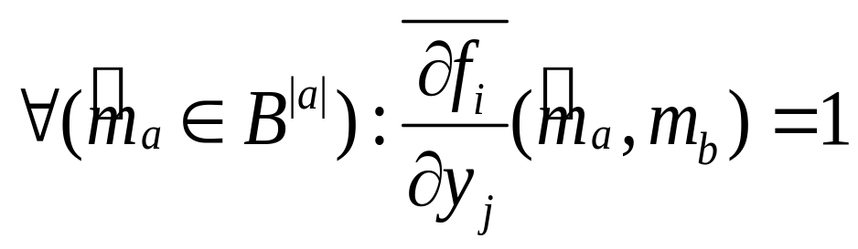
Compatible Don't Cares at Edges
Given {CODC_{[1,i]},…,CODC_{[j-1,i]}}
compute CODC_{[j,i]} (m) = 1 iff the
the value of y_{i} remains insensitive
to y_{j} under arbitrarily flipping of
the values of those y_{k} in the set:
a = { k∈FI_{i} | y_{k} < y_{j}, CODC_{[k,i]}(m) = 1 }
Equivalently, CODC_{[j,i]}(m) = 1 iff for

Slide 31
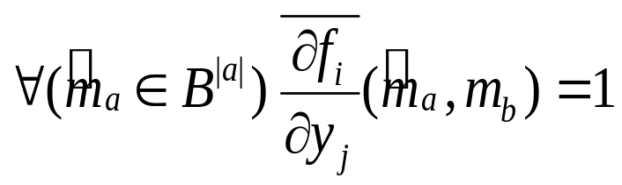

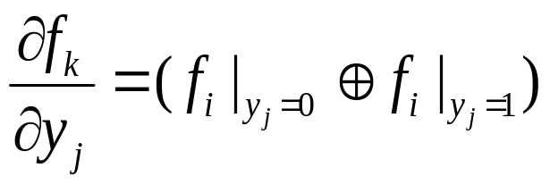
Compatible Don't Cares at Edges
Thus we are arbitrarily flipping the m_{a} part. In some sense m_{b} is enough to keep f_{i} insensitive to the value of y_{j}.
is called the Boolean difference of f_{i} with respect to y_{j} and is all conditions when f_{i} is sensitive to the value of y_{j}.

Slide 32
Compatible Don't Cares at a Node
Compatible don't care at a node j, CODC_{j}, can also be expressed as a function of the primary inputs.
if j is a primary output, CODC_{j} = XDC_{j}
otherwise,
  represent CODC_{[j,i]} by the primary inputs for each fanout edge [j,i].
  CODC_{j}= Π_{i∈FOj}(CODC_{i}+CODC_{[j,i]})
THEOREM:
The set of incompletely specified functions with the CODCs computed above for all the nodes provides a set of CSPFs for an arbitrary Boolean network.

Slide 33

Computations of CODC Subset
An easier method for computing a CODC subset on each fanin y_{k}of a function f is:
where CODC_{f} is the compatible don’t care already computed for node f, and where f has its inputs y₁, y₂ ,…, y_{r} in that order.
The notation for the operator, ∀y.f = f_{y} ∧ f_{‾y} , is used here.

Slide 34
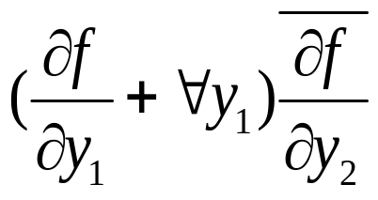
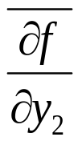
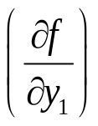
Computations of CODC Subset
The interpretation of the term for CODC_{y2}
is that: of the minterms m∈B^{r} where f is insensitive to y₂,
we allow m to be a don’t care of y₂ if
  either m is not a don’t care for the y₁ input or
  no matter what value is chosen for y₁, (∀.y₁), f is still insensitive to y₂ under m (f is insensitive at m for both values of y₂ )

Slide 35
Computation of Don't Cares
XDC is given, SDC is easy to compute
Transduction
  NOR­gate networks
  MSPF, CSPF (permissible functions of PI only)
Extension of CSPF's to CODCs) for general networks
  based on BDD computation
  can be expensive to compute, not maximal
  implementable functions of PI and y
Question:
  How do we represent XDC’s?
  How do we compute the local don’t care?

Slide 36

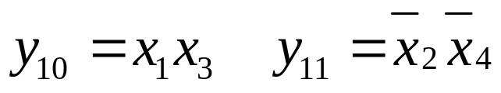
Representing XDC’s
XDC
f₁₂=y₁₀y₁₁
z (output)
y₁₂
ODC₂=y₁
or
separate
DC network
y₂
y₉
y₁
&
y₁₀
y₁₁
y₅
y₆
y₃
&
y₄
&
y₇
y₈
⊕
x₁
x₃
x₂
x₄
&
x₁
x₂
x₃
x₄
x₁
x₃
x₂
x₄
multi-level
Boolean network
for z

Slide 37
Mapping to Local Space
How can ODC + XDC be used for optimizing the representation of a node, y_{j}?
y_{j}
y_{l}
y_{r}
x₁
x₂
x_{n}

Slide 38
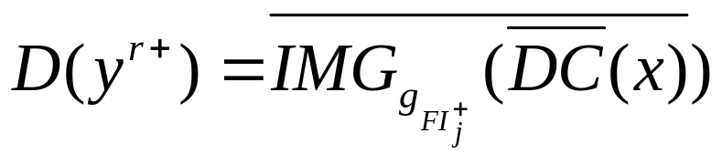
Mapping to Local Space
Definitions:
  The local space B^{r} of node j is the Boolean space of all the fanins of node j (plus maybe some other variables chosen selectively).
  A don’t care set D(y^{r+}) computed in local space (+) is called a local don’t care set.
  The “+” stands for additional variables.
Solution:
  Map DC(x) = ODC(x)+XDC(x) to local space of the node to find local don’t cares, i.e. we will compute

Slide 39
Computing Local Don’t Cares
The computation is done in two steps:
y_{j}
y_{l}
y_{r}
x₁
x₂
x_{n}
1. Find DC(x) in terms of primary inputs.
2. Find D, the local don’t care set, by image computation
and complementation.

Slide 40
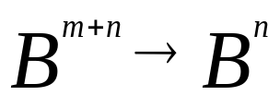
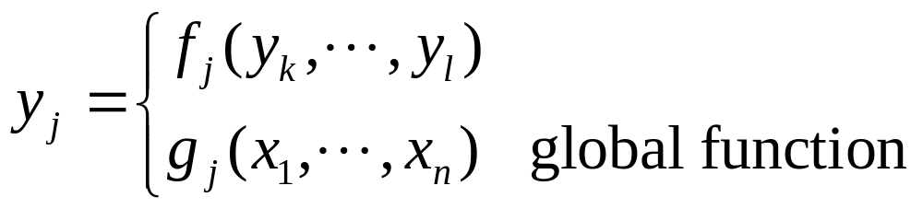
Map to Primary Input (PI) Space
y_{j}
y_{l}
y_{r}
x₁
x₂
x_{n}

Slide 41
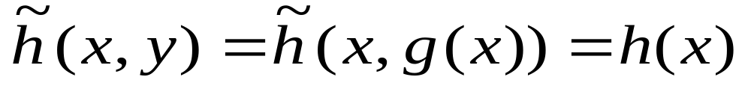
Map to Primary Input (PI) Space
Computation done with Binary Decision Diagrams
  Build BDD’s representing global functions at each node
    in both the primary network and the don’t care network, g_{j}(x₁,...,x_{n})
    use BDD_compose
  Replace all the intermediate variables in (ODC+XDC) with their global BDD
  Use BDD’s to substitute for y in the above (using BDD_compose)
~
h
(
x
,
y
)
=
ODC(x,y)+DC(x,y)
→
h
(
x
)
=
DC(x)

Slide 42
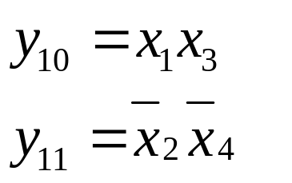
Example
XDC
f₁₂=y₁₀y₁₁
z (output)
ODC₂=y₁
or
y₁₂
separate
DC network
y₂
y₉
y₁
&
y₁₀
y₁₁
y₅
y₆
y₃
&
y₄
&
y₇
y₈
⊕
x₁
x₃
x₂
x₄
&
ODC
=
y
x₁
x₃
x₄
x₁
x₂
x₄
2
1
x₂
x₃
g
=
x
x
x
x
1
1
2
3
4
XDC₂
=
y
multi-level
network
for z
12
g
=
x
x
x
x
12
1
2
3
4
DC
=
ODC
+
XDC
2
2
z
DC
=
x
x
x
x
+
x
x
x
x
2
1
2
3
4
1
2
3
4

Slide 43
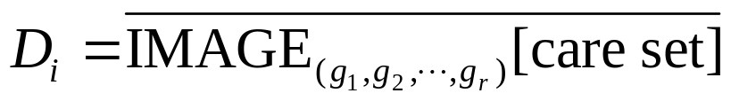
Image Computation
image of care
set under
mapping y₁,...,y_{r}
local
space
y_{j}
B^{r}
y_{i}
y_{r}
g_{i}
g_{r}
D_{i}
image
B^{n}
x₁
x₂
x_{n}
DC_{i}=XDC_{i}+ODC_{i}
care set
Local don’t cares are the set of minterms in the local space of y_{i} that cannot be reached under any input combination in the care set of y_{i} (in terms of the input variables).
Local don’t Care Set:
i.e. those patterns of (y₁,...,y_{r}) that never appear as images of input cares.

Slide 44
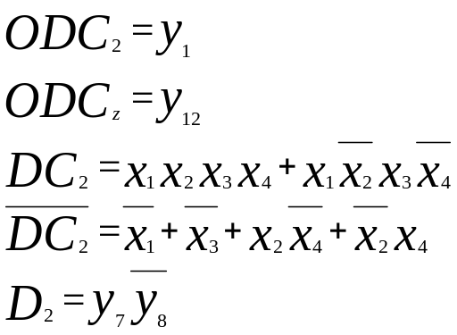
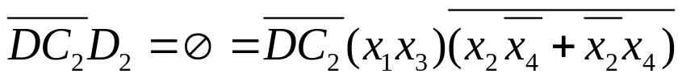


Example
XDC
f₁₂=y₁₀y₁₁
z (output)
ODC₂=y₁
or
y₁₂
separate
DC network
y₂
y₉
y₁
&
y₁₀
y₁₁
y₅
y₆
y₃
&
y₄
&
y₇
y₈
⊕
x₁
x₃
x₂
x₄
&
x₁
x₂
x₃
x₄
x₁
x₃
x₂
x₄
Note that D₂ is given in this space y₅, y₆, y₇, y₈.
Thus in the space (- - 10) never occurs.
Can check that
Using , f₂ can be simplified to

Slide 45

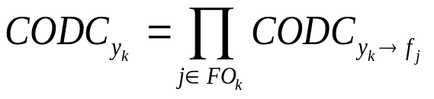
Full_Simplify Algorithm
Visit node in topological reverse order i.e. from outputs.
Compute compatible ODC_{i}
  compatibility done with intermediate y variables
BDD’s built to get this don’t care set in terms of primary inputs (DC_{i})
Image computation techniques used to find local don’t cares D_{i} at each node
XDC_{i}(x,y) + ODC_{i} (x,y) → DC_{i}(x) → D_{i}( y ^{r} )
where ODC_{i} is a compatible don’t care at node i (we are loosing some freedom)
f
y₁
y_{k}

Slide 46
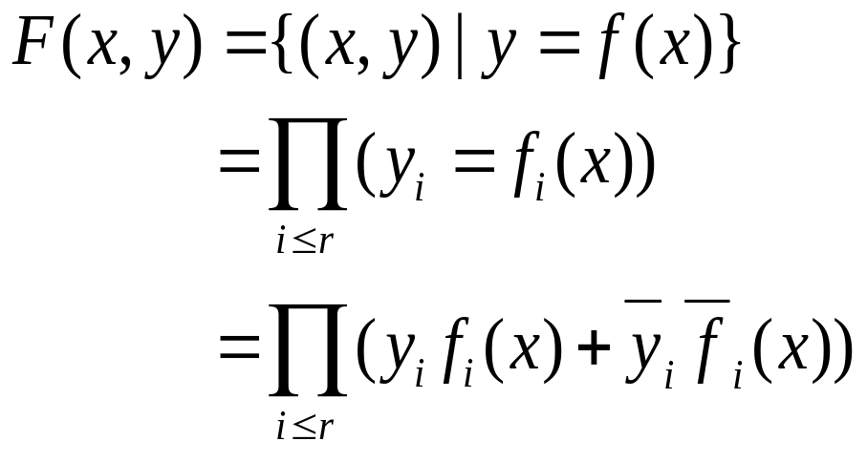
Image Computation: Two methods
Transition Relation Method
f : B^{n} → B^{r} ⇒ F : B^{n} x B^{r} → B
F is the characteristic function of f.

Slide 47
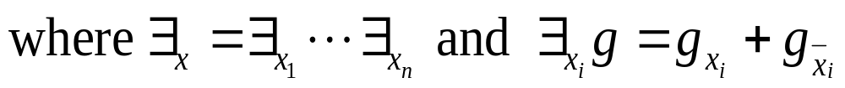
Transition Relation Method
Image of set A under f
f(A) = ∃_{x}(F(x,y)A(x))
The existential quantification ∃_{x} is also called “smoothing”
Note: The result is a BDD representing the image, i.e. f(A) is a BDD with the property that
BDD(y) = 1 ⇔ ∃x such that f(x) = y and x ∈ A.
f
A
f(A)
x
y

Slide 48
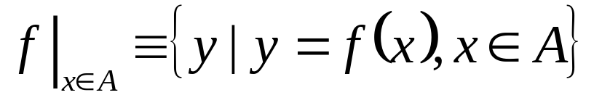
Recursive Image Computation
Problem:
Given f : B^{n} → B^{r} and A(x) ⊆ B^{n}
Compute:
Step 1: compute CONSTRAIN (f,A(x)) ≡ f_{A(x)}
f and A are represented by BDD’s. CONSTRAIN is a built-in BDD operation. It is related to generalized cofactor with the don’t cares used in a particular way to make
1. the BDD smaller and
2. an image computation into a range computation.
Step 2: compute range of f_{A(x)}.
f_{A(x)} : B^{n} → B^{r}

Slide 49
Recursive Image Computation
Property of CONSTRAIN (f,A) ≡ f_{A(x)}:
(f_{A(x)})|_{x∈B}^{n} = f|_{x∈A}
f
A
f_{A}
f(A)
range of f_{A}(B^{n})
B^{n}
B^{r}
range of f(B^{n})

Slide 50



Recursive Image Computation
1. Method:
B^{n}
B^{r} = (y₁,...,y_{r})
This is called input cofactoring or domain partitioning

Slide 51
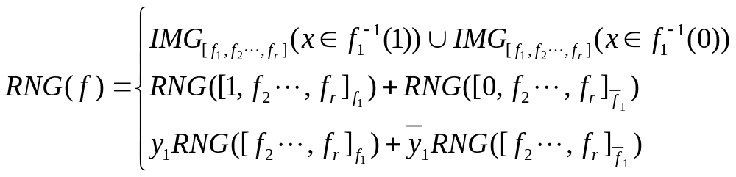

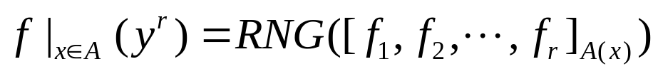
Recursive Image Computation
2. Method:
where here refers to the CONSTRAIN operator.
(This is called output cofactoring of co-domain partitioning).
Thus
Notes: This is a recursive call. Could use 1. or 2 at any point.
The input is a set of BDD’s and the output can be either a set of cubes or a BDD.

Slide 52
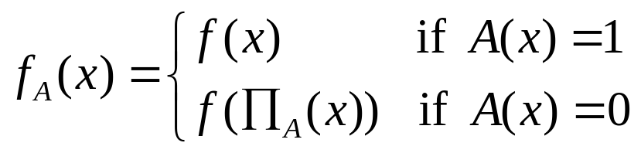
Constrain Illustrated
f
A
0
0
X
X
Idea:
Map subspace (say cube c in B^{n}) which is entirely in DC
(i.e. A(c) ≡ 0) into nearest non-don’t care subspace
(i.e. A ≠ 0).
where Π_{A}(x) is the “nearest” point in B^{n} such that A = 1 there.

Slide 53
Simplify
XDC
outputs
Don’t
Care
network
f_{j}
m intermediate
nodes
inputs ∈ B^{n}
Express ODC in terms of variables in B^{n+m}

Slide 54

Simplify
Express ODC in terms of variables in B^{n+m}
B^{n}
B^{n+m}
B^{r}
ODC+XDC
DC
D
compose
cares
cares
image
computation
Minimize f_{j}
don’t care = D
f_{j}
local
space B^{r}
Question: Where is the SDC coming in and playing a roll?

Slide 55
Minimizing Local Functions
Once an incompletely specified function (ISF) is derived, we minimize it.
1. Minimize the number of literals
  Minimum literal() in the slides for Boolean division
2. The off­set of the function may be too large.
  Reduced offset minimization (built into ESPRESSO in SIS)
  Tautology­based minimization
If all else fails, use ATPG techniques to remove redundancies.

Slide 56
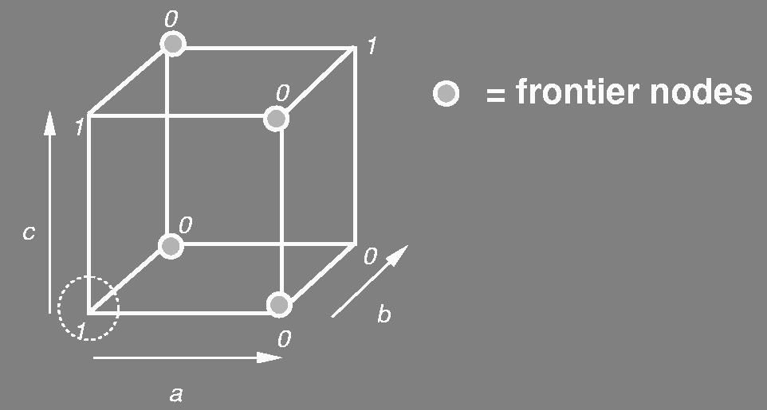
Reduced Offset
Idea:
In expanding any single cube, only part of
the off­set is useful. This part is called the
reduced offset for that cube.
Example:
In expanding the cube
a b c the point abc is
of no use. Therefore
during this expansion
abc might as well be put
in the offset.
Then the offset which was ab + ab + bc becomes a + b. The reduced offset of an individual on-set cube is always unate.

Slide 57
Tautology­based Two­Level Min.
In this, two­level minimization is done without using the offset. Offset is used for blocking the expansion of a cube too far. The other method of expansion is based on tautology.
Example:
In expanding a cube c = a’beg’ to aeg’ we can test if aeg’ ⊆ f +d. This can be done by testing
  (f +d)_{aeg’} ≡ 1 (i.e. Is (f + d) _{aeg’} a tautology? )

Slide 58
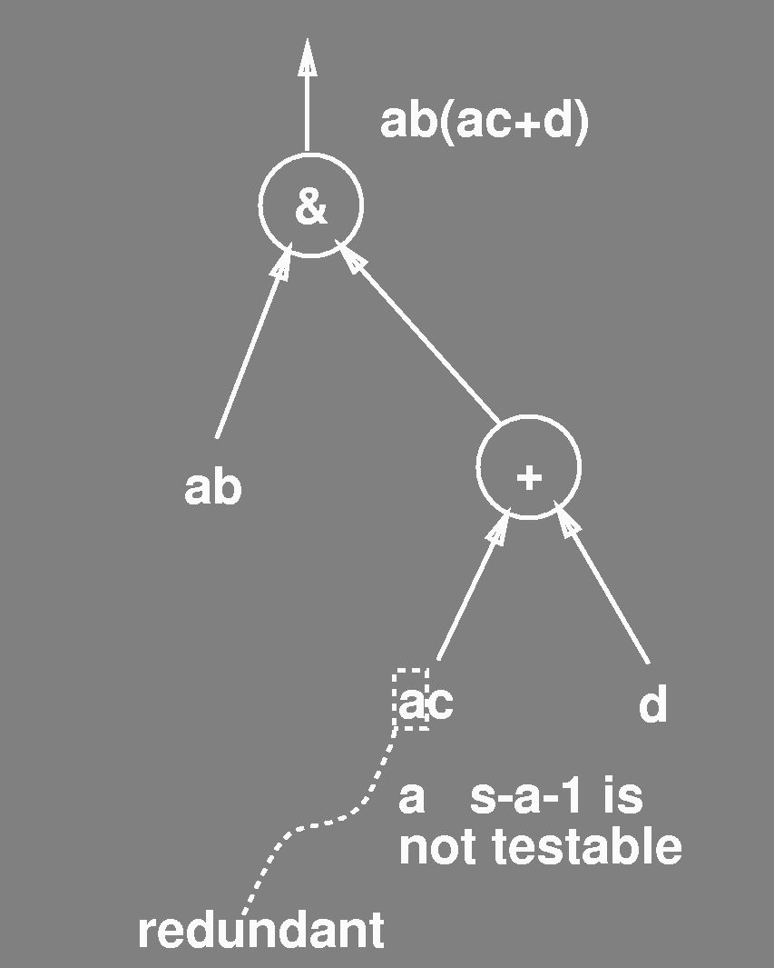
ATPG
Multi­Level Tautology:
Idea:
Use testing methods. (ATPG is a highly developed technology). If we can prove that a fault is untestable, then the untestable signal can be set to a constant.
This is like expansion in Espresso.

Slide 59
Removing Redundancies
Redundancy removal:
do random testing to locate easy tests
apply new ATPG methods to prove testability of remaining faults.
  if non-testable for s-a-1, set to 1
  if non-testable for s-a-0, set to 0
Reduction (redundancy addition) is the reverse of this.
It is done to make something else untestable.
There is a close analogy with reduction in espresso. Here also reduction is used to move away from a local minimum.
&
reduction = add an input
d
a
c
b
Used in transduction (Muroga)
Global flow (Bermen and Trevellan)
Redundancy addition and removal (Marek-Sadowska et. al.)

